Slide 1
Edward R. Murrow HS

Slide 2
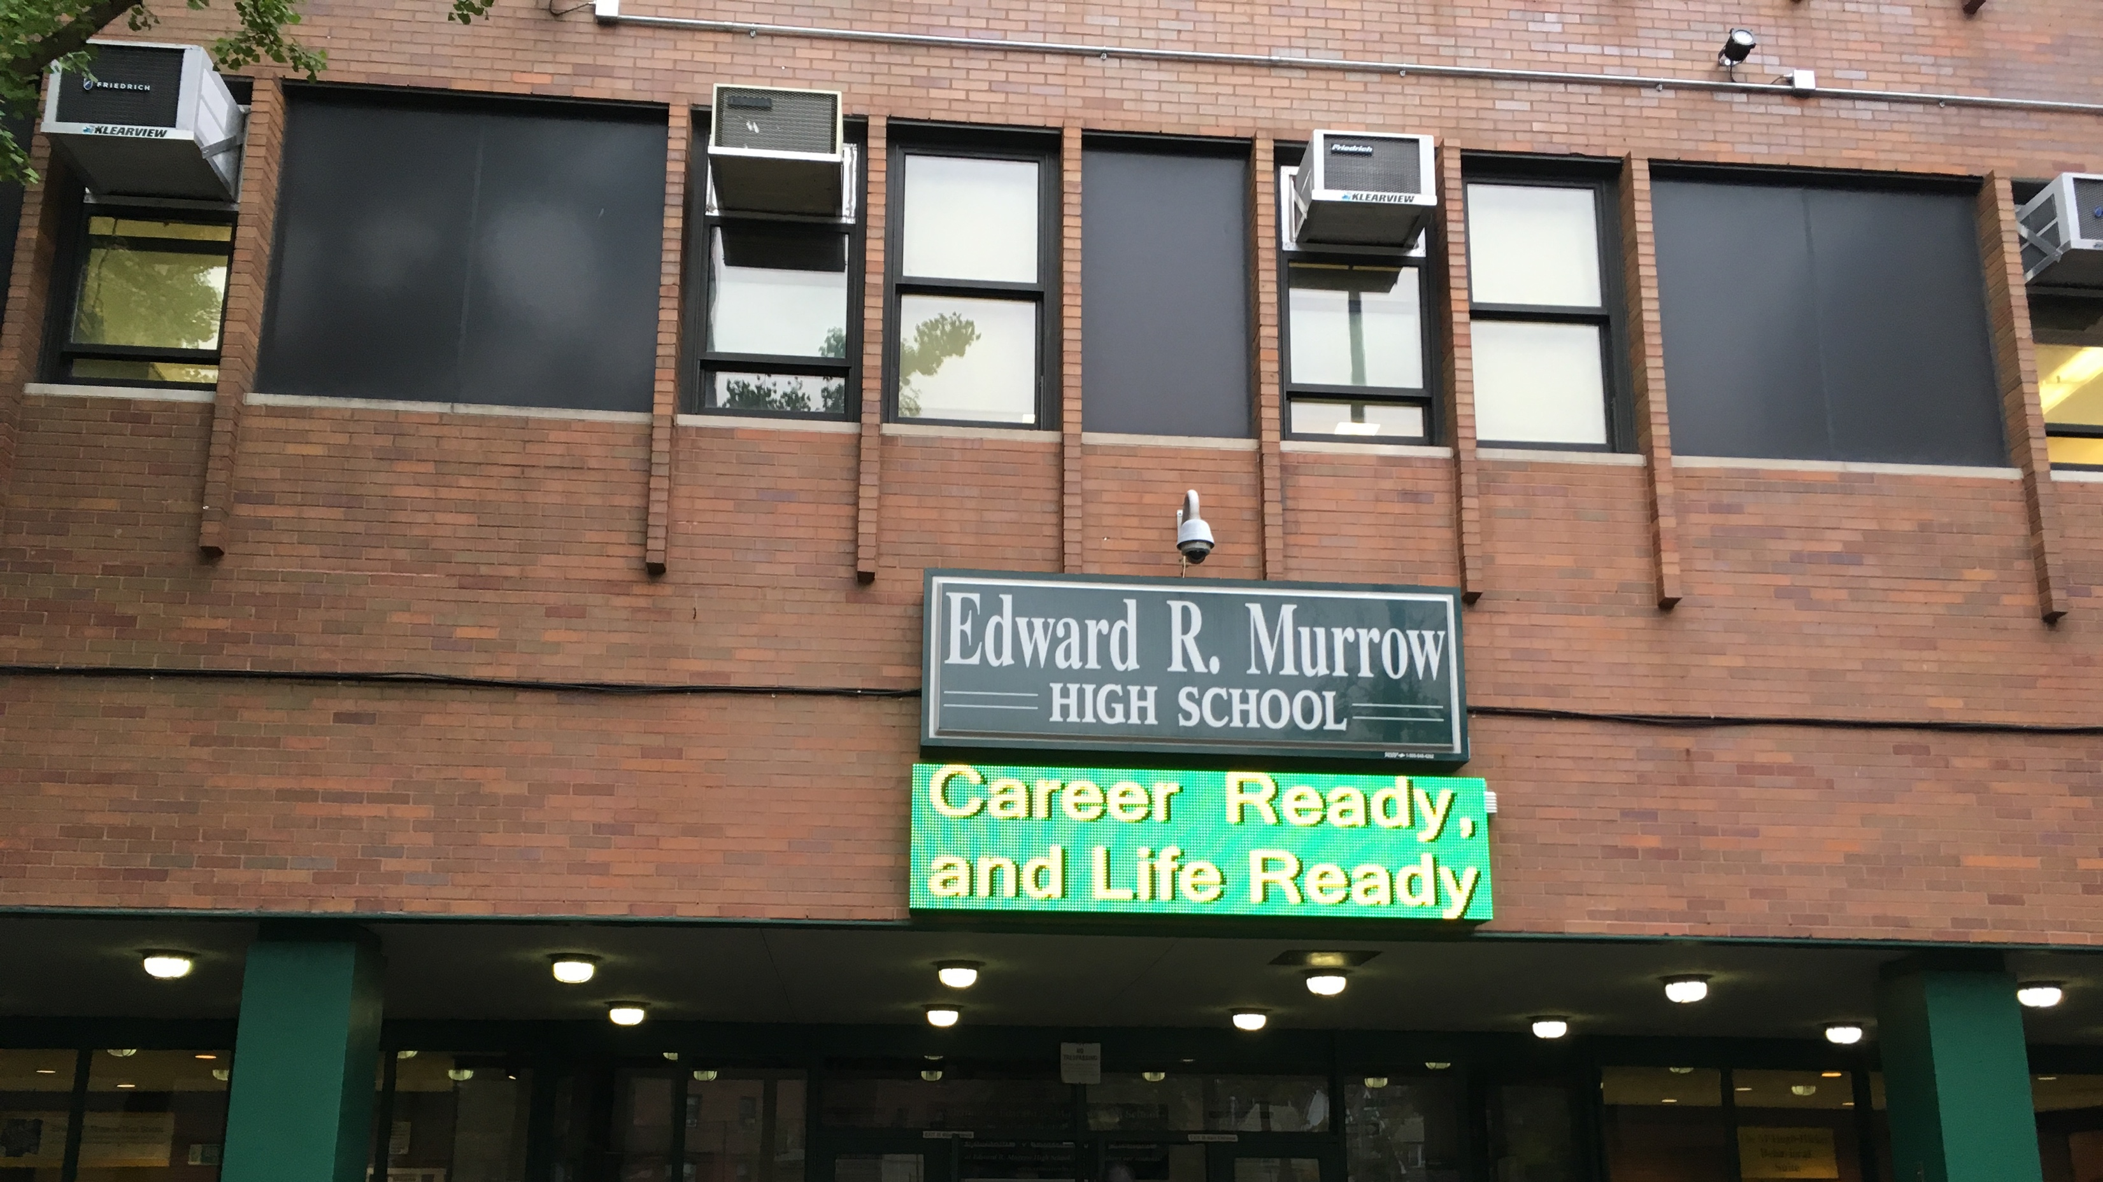

Slide 4
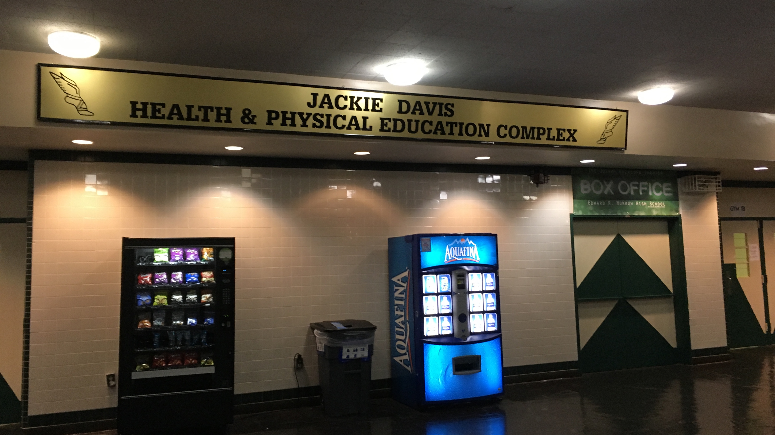

Slide 5
