Slide 1
Family and Intimate Relationship
Chapter 14

Slide 2
Family
Family: set of people related by blood, marriage, or some other agreed-upon relationship, or adoption who share primary responsibility for reproduction and caring for members of society
Nuclear family: nucleus or core upon which larger family groups are built
Extended family: family in which relatives live in same home as parents and their children

Slide 3
Romantic Relationships
Monogamy: form of marriage in which one woman and one man are married only to each other
Serial monogamy: when a person has several spouses in his or her lifetime, but only one spouse at a time
Polygamy: when an individual has several husbands or wives simultaneously
Polygyny: marriage of a man to more than one woman at a time
Polyandry: marriage of a woman to more than one husband at the same time
Exceedingly rare

Slide 4
Kinship Patterns
Kinship: state of being related to others
Bilateral descent: both sides of person’s family equally important
Patrilineal descent: only father’s relatives are significant
Matrilineal descent: only mother’s relatives are significant

Slide 5
Authority Patterns
Patriarchy: males are expected to dominate in all family decision making
Matriarchy: women have greater authority than men
Egalitarian family: family in which spouses are regarded as equals

Slide 6
Sexual Orientation
Heterosexuality
Homosexuality
Bisexuality
Asexuality
5.6% of adult men and 12.7% of adult women report engaging in homosexual activity at some point in their lives.
1.7% (men) 1.1% (women) define themselves as homosexual

Slide 7
Teen Pregnancy Across the US
What patterns do you see?
What explanation can you come up with?

Slide 8
Courtship and Mate Selection
Aspects of Mate Selection
Many societies have explicit or unstated rules that define acceptable mates
Endogamy: specifies groups within which a spouse must be found and prohibits marriage with members of other groups
Exogamy: requires mate selection outside certain groups, usually one’s own family or certain kin
Incest taboo: social norm common to all societies that prohibits sexual relationships between certain culturally specified relationships
Homogamy: conscious or unconscious tendency to select mate with personal characteristics similar to one’s own

Slide 9
Arrange Marriages
Today, arranged marriage is largely practiced in Asia (India, Nepal, Pakistan, Bangladesh, Sri Lanka),Africa, the Middle East
Arranged marriages are usually decided by the parents or an older family member. The match could be selected by parents, a matchmaking agent, or a trusted third party. In many communities, priests or religious leaders as well as relatives or family friends play a major role in matchmaking
Arranged marriages vary in both nature and duration of time from meeting to engagement. In an "introduction only" arranged marriage, the parents may only introduce their son or daughter to a potential spouse. From that point on, it is up to the children to manage the relationship and make a choice. There is no set time period.

Slide 10
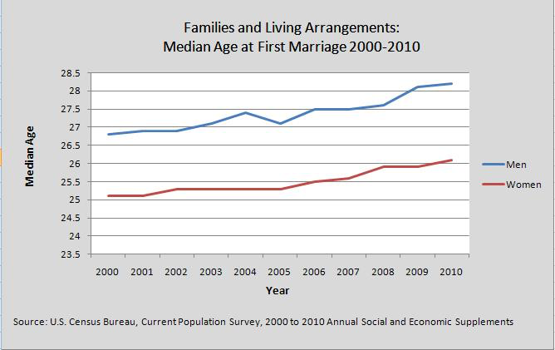
The U.S. Family
The average American family in 2014 consisted of 3.13 persons.

Slide 11
Contraceptives Used Among Married Women

Slide 12
First-Cousin Marriage Laws

Slide 13
Dual-Income Families
Among married people between the ages of 25 and 34, 95% of men and 68% of women were in the labor force in 2005

Slide 14
Prenuptial Agreement
You are much wealthier than your partner.
You earn much more than your partner.
You are remarrying. When you remarry, your legal and financial concerns are often very different than in your first marriage. You may have children from a previous marriage, support obligations, and own a home or other significant assets. A prenuptial agreement can ensure that when you pass away, your assets are distributed according to your wishes, and that neither your first family, nor your new family are cut off.
Your partner has a high debt load.
You own part of a business. Without a prenuptial agreement, when your marriage ends, your spouse could end up owning a share of your business.
To prevent your spouse from overturning your estate plan. A prenuptial agreement can ensure that you estate plan works, and, for instance, ensure that a specific heirloom remains in your family.
If you plan to quit your job to raise children. Quitting your job will negatively impact your income and your wealth. A prenuptial agreement can ensure that the financial burden of raising the children is shared fairly by both partners.

Slide 15
Divorce
Divorce rates increased in late 1960s, started to level and decline since late 1980s
Women less likely than men to remarry because many retain custody of children
Greater social acceptance of divorce
More liberal divorce laws
About a third of children benefit from divorce because it lessens exposure to conflict

Slide 16
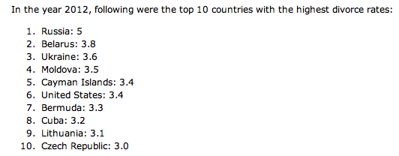
Divorce

Slide 17
Economic Perspective
Median age at first marriage has increased as more people wait to be economically secure
Number of children has decreased because of economic insecurity
Number of dual income households have increased due to economic reasons
Divorce rates have increased
Number of single parent households have increased (especially African Americans)

Slide 18
Traditional Family
Some suggest that parents put children ahead of their own careers by limiting their joint workweek to 60 hrs. Agree?
Some suggest that marriage is weaker today because women are rejecting patriarchal relationships. Agree?

Slide 19
The Four Parenting Styles
Authoritarian Parenting Children are expected to follow the strict rules. Failure to follow rules results in punishment. Parents fail to explain the reasoning behind the rules.
Authoritative Parenting Children are expected to follow the strict rules established by the parents. Authoritative parents are responsive to their children and willing to listen to questions. When children fail to meet the expectations, these parents are more nurturing and forgiving rather than punishing. Their disciplinary methods are supportive, rather than punitive.
Permissive Parenting Permissive parents have very few demands to make of their children. These parents rarely discipline their children because they have relatively low expectations of maturity and self-control. They are generally nurturing and communicative with their children, often taking on the status of a friend more than that of a parent.
Uninvolved Parenting An uninvolved parenting style is characterized by few demands, low responsiveness and little communication. While these parents fulfill the child's basic needs, they are generally detached from their child's life.

Slide 20
Group Work
Paste the action into the correct parenting style column
Under each column explain the psychological impact of the style. (How would each parenting style impact the children involved? )

Slide 21
Types of Families
Interracial Marriage | Interfaith marriage | Gay Marriage | Adoption
When two people of differing racial groups marry Loving v. Virginia, (1967), SCOTUS ruled that laws prohibiting interracial marriage are unconstitutional | Marriage between partners professing different religions. The Universal Declaration of Human Rights (1948), states that men and women who have reached the age of majority have the right to marry "without any limitation due to race, nationality or religion” although many religions still frown upon it | Marriage between partners of the same sex. Obergefell v. Hodges (2015), SCOTUS ruled that state-level bans on same-sex marriage are unconstitutional. | Adoption is a process where a person assumes the parenting for another and permanently transfers all rights and responsibilities from the original parents. 120,000 families looking to adopt each year. 20,000 or more U.S.-born infants are placed for adoption every year About 1 million children in the U.S. live with adoptive parents. Mothers who give up their children: are more likely to finish school, less likely to live in poverty and receive public assistance Adopted teens are more likely to live with two parents in a middle-class family.

Slide 22
Psychological Perspective
Four types of parenting styles
Authoritative
Authoritarian
Permissive
Uninvolved
The type of parenting style will impact the child
The type of family a child is raised in will also impact the child

Slide 23
Essay #3
Explain the type of household a child can be raised in. (2 households – single family, gay, parenting type etc.)
Counter Argument
Evaluate which type of household will produce the best child.

